Slide 1


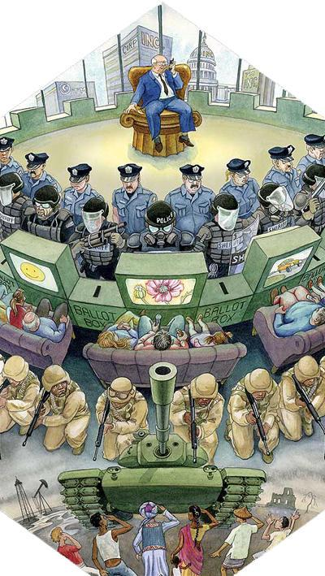
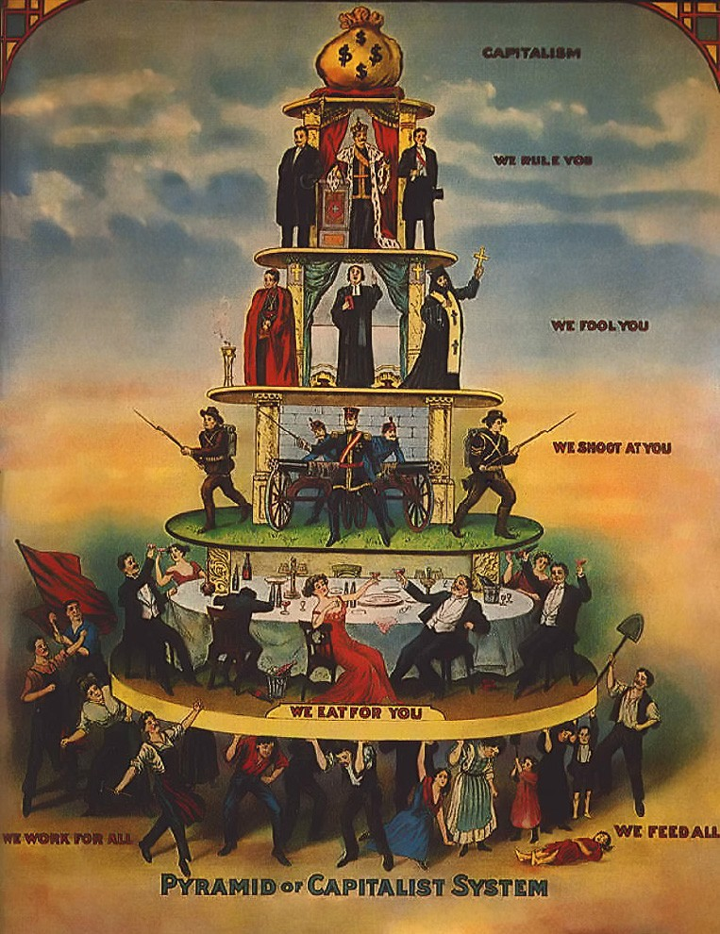








Knowledge and Education should be open and free.
Hierarchy and Exploitation must be abolished.

Slide 2
There are people whose political goals are threatened by an educated populace. They won't say that, though. It's usually some version of "I don't want to pay for someone else's education." - Teekno.
A dull, weak, and indulged population is easier to control. Just look at the obesity rate, the low attention span, and the prevalence of consumerism advertisement/propaganda, pornography, and promiscuity worldwide. "The engineering of consent". The war machine - the military industrial complex. It's just rebranded Autocratic Feudalism.
Wage slavery refers to a person's dependence on wages or a salary for their livelihood, in a world where the distribution of and conditions for these wages is determined by a specific class.

Slide 3
Landlords, executives, entertainers, and trust fund kids are the parasites of society; most of the wealth in the world is inherited.
Landlords are targeting vulnerable tenants to solicit sex in exchange for rent; child prostitution in Thailand, many other South-East Asian countries, and even the in West (Epstein) that serves the sex tourism industry for both local elites and foreign creepers.
Landlord’s right has its origins in robbery. They demand a rent even for the natural produce of the earth. - Karl Marx & Adam Smith.

Slide 4

Middle managers and executives always fall up, whereby the plebs get evicted solely for the numbers to look good to the shareholders; while their trucks are literally killing us.
95% of the job market is filled with fake postings, nepotism, cronyism, and favoritism; this is while ignoring data from India, where slavery and poverty are embedded in society via the caste system, and nearly 100% of the jobs are filled with nepotism. And good luck finding a job as an active anarchist, you’ll always be perceived as a threat to any establishment.

Slide 5

They all benefit from labor they didn't do. They are just useless middleman who profits from poverty, homelessness, and hostile architecture. And the current system supports and protects that status quo. Meanwhile, the grifters are always ready to cash in on people's insecurities.
People in need of a shelter are fucked because the elites hoard and monopolize all the housing for their own (and their children's) gain.
The current annual wage to house price ratio in the US is 7.5, in the UK it's 14, meanwhile it's 32.5 in Vietnam; people on average spend 50% of their income on rent.

Slide 6
The global north elites who got rich from colonialism are pushing greenwashing propaganda to the plebs, meanwhile they're flying private jets and yachts to climate change summits and ramping up lithium and deep-sea mining; Slavery in the dictatorship oil states (Saudi Arabia, UAE, Qatar, etc.) got swept under the rug through sportswashing and terrorism.
The capitalism fallacy of choice and democracy is just purely an illusion, or at least only happens in the upper echelon of society. Telling a minimum wagie to just choose a different employee is like telling a starving kid in a wartorned African country to just choose to be born from different parents from a different country.
The elites possess the asymmetry of power and the asymmetry of information, hence it always ends up in manipulation and corruption; they have all the nukes, all the lands in New Zealand, underground cities, and luxury bunkers prepared for the worst, while safely farming the population.

Slide 7
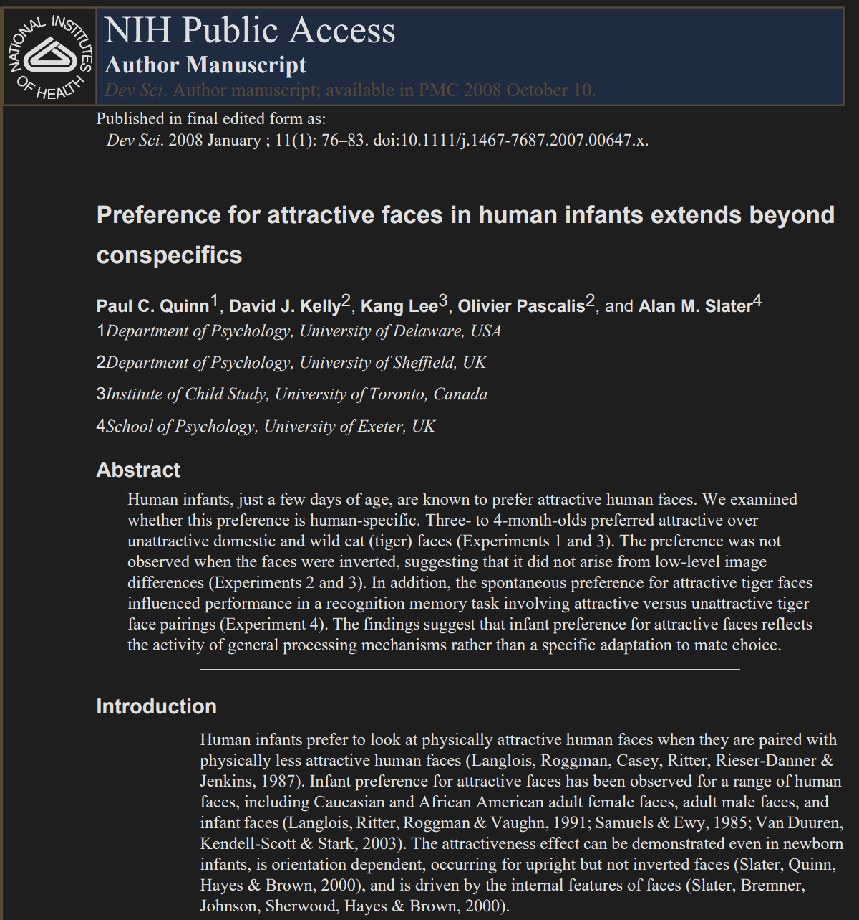
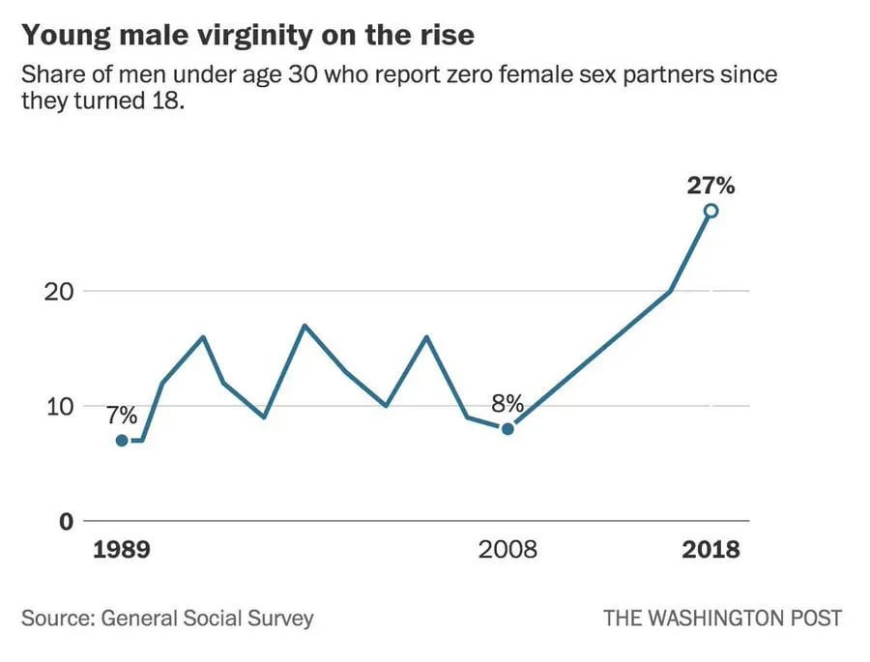
Human attractiveness is not subjective, who says otherwise is lying, has ulterior motives, or is just in denial.

Slide 8


There will always be people who ready to take advantage of others no matter which system and ideology are in charge; in fact, they will always be the majority. The world is rigged for a pleb. Poverty and Slavery are and always will be Systemic. We're truly fucked. It's over.
No, it's not even begun. The only path forward is the Noble Eightfold Path taught by the Buddha, to escape this suffering-filled shithole once and for all.

Slide 9
Bonus tips: How to relocate critters without harming them:
cockroaches, millipedes, centipedes, spiders, etc. -> opened box place in front of their run path, and then relocate them far away in a suitable environment for them.
mice -> humane cage, and then relocate them far away in a suitable environment for them.
ants, termites -> don't drop your foods, use fewer wood furniture, clean up old storerooms and damp corners, let them eat and leave on their own.

Slide 10
Free education/anthropology resources collection: https://gist.github.com/lavantien/dc730dad7d7e8157000ddae845eddfd7#b-linguistics-english-psychology-anthropology-history-philosophy-economics-business-cooking-medical
What the Buddha really taught: https://gist.github.com/lavantien/5789220c9f07c8b5e0b8728b4ac53df6
The Horned Rhino - The Doomer’s Way: https://suttacentral.net/snp1.3/en/sujato?lang=en&layout=plain&reference=none&notes=sidenotes&highlight=true&script=latin
Why am I an Anarchist: https://youtu.be/jwFOZX813iw?si=FJ9IgNKqGux2TXeP
Buddhism and Anarchism: Exploring the Unlikely Compatibility of Two Distinct Traditions: https://voidnetwork.gr/2021/02/22/buddhism-and-anarchism-exploring-the-unlikely-compatibility-of-two-distinct-traditions/
Homelessness and Debunking Arguments Landlords Use to Justify Their Existence: https://youtu.be/LknfkLPLt1E?si=fQ9KYpMGXzpoyomp
These Stupid Trucks are Literally Killing Us: https://youtu.be/jN7mSXMruEo?si=DNDewhR4orqtbSA2
Wage Slavery & Anticapitalist Slavers: https://youtu.be/3NFQzu05SAI?si=DWwnLRlGYb49IkBM
The State is Counter-Revolutionary: https://youtu.be/uTwxpTyGUOI?si=5TuzKOl3y-C3Q9bN
How The Barter Myth Harms Us: https://youtu.be/W-gdHrINyMU?si=bvxefyrLUM3f4CAi

Slide 11
Back to Work Wagie: https://youtu.be/4JsgrXyBZO0?si=dCBDmgVp5Ncn45EH
Clean It Up, Wagie: https://youtu.be/xHJrBdr6UNc?si=UyB2RAALr8y4Ga4l
Thank You From a Land Speculator: https://youtu.be/xqQhoZgFZgk?si=8CY3uFrz6xgzOyNZ
A Brief History Of The Man Who Brainwashed America: Edward Bernays: https://youtu.be/GdQ6HIzaSm4?si=rIcq1Dtt_L7RJIjS
Landlords are targeting vulnerable tenants to solicit sex in exchange for rent: https://www.nbcnews.com/news/us-news/landlords-are-targeting-vulnerable-tenants-solicit-sex-exchange-rent-advocates-n1186416
Pleasure Trips or Underage Sex Tourism: https://youtu.be/7B15XDJbJBU?si=bBT9Fw_DH-5izRCh
Sex tourists in Thailand | DW Documentary: https://youtu.be/W6vBvB1Fyjo?si=9nqSrONeEovzdtz9
Jeffrey Epstein got epsteined: https://youtu.be/33GdIBrdmc0?si=knBZWtMkfNFhL4MH
Human attractiveness is not subjective: https://www.ncbi.nlm.nih.gov/pmc/articles/PMC2566458/
The Super Rich’s Secret Doomsday Bunkers | WHILE THE REST OF US DIE: https://youtu.be/uQin210ZBAQ?si=Tn0dMU8eFJxLm_l1
Hunting the One Percent’s Doomsday Bunkers in New Zealand: https://youtu.be/Dh1JZVjKUAo?si=QLXcZNna8GjEGKT2
The Illusion of Democracy | Who Really Controls our Lives: https://youtu.be/mhOOziH7QAo?si=wWd3ZKLGmdpZCV_H
Greenwashing: When Companies Aren’t as Sustainable as They Claim | WSJ: https://www.youtube.com/watch?v=2NsBcVrPQok
Kurzgesagt and the art of climate greenwashing: https://www.youtube.com/watch?v=uCuy1DaQzWI

Slide 12
History of Arab Slave Trade: https://www.youtube.com/watch?v=5OdIqeWkhHU
Migrant workers forced to work for no pay: https://www.youtube.com/watch?v=e5R9Ur44XV8
Nepotism in India: https://morungexpress.com/nepotism-in-india
How Kashmiris Got So Good At Smoking Indian Soldiers: https://youtu.be/cvhddK3tWNY?si=rvJ_eRBiDCJE9N-W
Most of the wealth accumulated by new billionaires in 2023 came from inheritance: https://www.investopedia.com/more-billionaire-wealth-achieved-through-inheritance-overtaking-entrepreneurship-8409800
Why Does Taylor Swift Use Her Private Jet So Much: https://youtu.be/A6eKgOw9KO8?si=a1jXUc7f3LXNXYY_
As of November 2021, that ratio was 7.5 times: https://www.crews.bank/blog/real-estate-prices-vs.-income
House prices: the average London home now costs 14 times the typical household income: https://www.standard.co.uk/homesandproperty/property-news/average-home-cost-times-typical-income-london-b1097122.html
HCMC home price 32.5 times household income: https://e.vnexpress.net/news/data-speaks/hcmc-home-price-32-5-times-household-income-4615105.html

Slide 13

Good luck in this depraved and chaotic world.

